Slide 1
COHORT ANALYSIS FOR CUSTOMER RETENTION
Juliana Robinson

Slide 2
BUSINESS PROBLEM
ShopSphere gets many new customers, but:
Many customers only buy once
Customers stop using the platform after their first purchase
Customer activity drops over time
It is difficult to understand how different customer groups behave
This causes:
Lower repeat purchases
Higher marketing costs to attract new customers again
Weak customer loyalty
Unstable long-term growth

Slide 3
OBJECTIVE
To understand how customers behave over time using cohort
To Measure customer retention after first purchase
To find when customers stop using the platform
To compare different customer groups and their retention
To improve customer loyalty and increase repeat purchases

Slide 4
DATA OVERVIEW
No missing values, Date column converted to datetime, no duplicates
Features include customer details, transaction information, product details, and purchase location.
The dataset contains 385,314 transaction records and 8 features
Time-based data used for cohort analysis Key variables are Invoice Date, Quantity, Price

Slide 5
FEATURE ENGINEERING SUMMARY
Creating Revenue from Quantity × Unit Price
Extracting Month/Year from Invoice Date
Creating Cohort Month (first purchase)
Building Cohort Index to track behavior over time

Slide 6
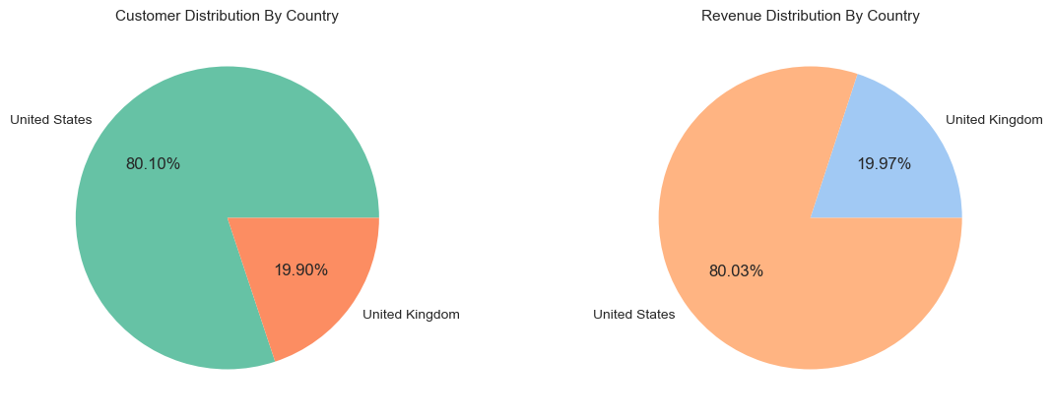
BUSINESS TREND
United States dominates both customer count and revenue
Revenue growth is mainly driven by higher number of customers, not higher spending per user
United Kingdom shows comparatively lower activity

Slide 7
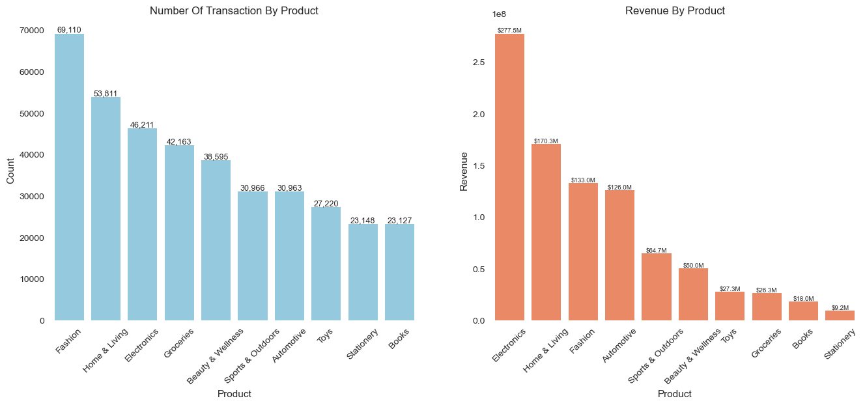
PRODUCT INSIGHT
Fashion is the most frequently purchased category, followed by Home & Living and Electronics Indicating a strong demand in lifestyle and retail products

Slide 8
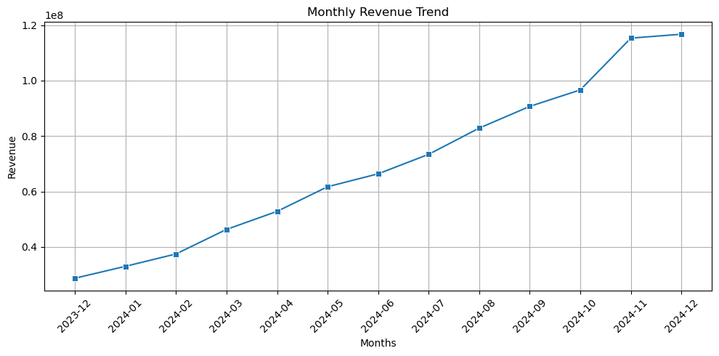
REVENUE TREND
Revenue shows a consistent upward trend throughout the year.
Gradual growth from Dec 2023 to Oct 2024 indicates steady business expansion
A sharp increase between Oct and Nov suggests a possible seasonal effect or successful campaign.
Revenue peaks in Nov–Dec 2024, showing strongest performance at year-end.
Overall, the business demonstrates strong growth with peak performance in the final quarter (Q4)

Slide 9
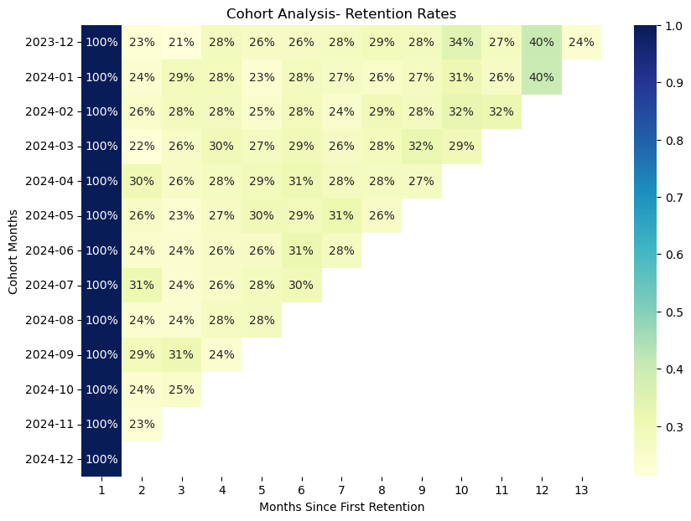
COHORT ANALYSIS INSIGHT
Retention drops sharply after the first month (~20–30%)
Retention stabilizes in later months with consistent returning customers
No cohort shows strong long-term retention
Recent cohorts have limited data for later months
Early customer drop-off is high, highlighting the need to improve first-month engagement and retention

Slide 10
MODEL DEVELOPMENT PIPELINE
Customer Data
RFM Analysis
(Recency, Frequency, Monetary)
Feature Scaling
K-means Clustering
Customer Segment
(Champion | Royal | At risk | VIP)

Slide 11
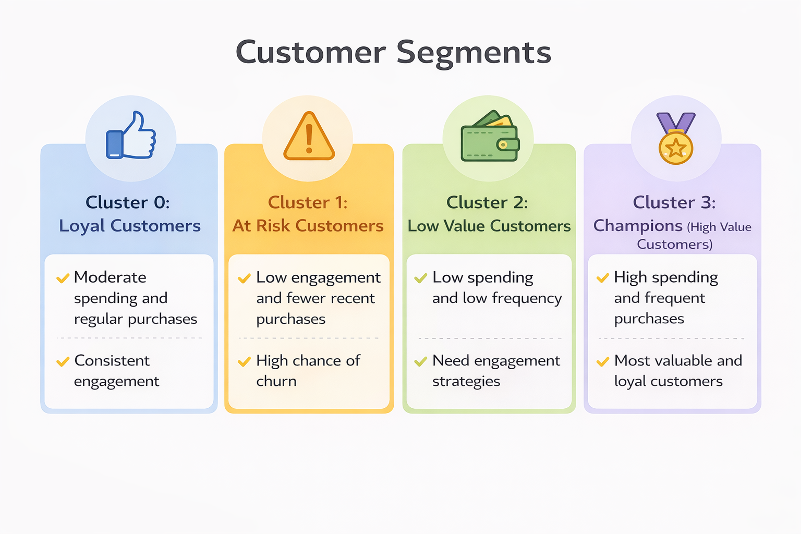
CUSTOMER BEHAVIOR SEGMENTATION FRAMEWORK
Customers are segmented using RFM analysis and K-Means clustering to understand their buying behaviour.
This helps group customers based on how recently, how often, and how much they purchase. Each group shows different patterns such as loyal users, inactive users, and high-value customers.
These insights help the business create targeted marketing strategies to improve retention and increase revenue.

Slide 12
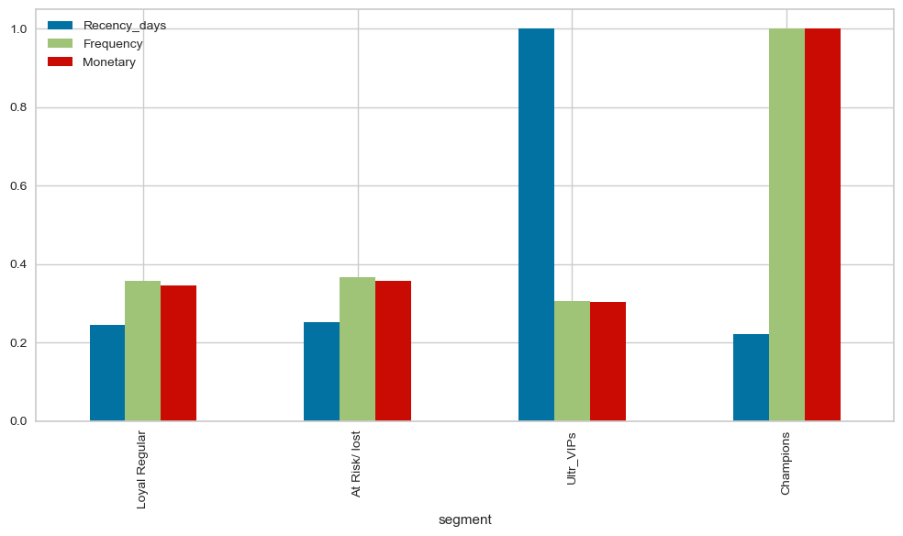
SEGMENT PERFORMANCE OVERVIEW
Champions are the most valuable segment, with the highest purchase frequency and revenue contribution
Ultra VIPs show recent activity but lower overall spending and engagement
Loyal Regulars maintain steady behaviour but do not drive significant revenue
At Risk / Lost customers show declining engagement, indicating potential churn
A clear performance gap exists between top-tier customers and other segments

Slide 13
LIMITATIONS
Analysis is based only on historical transaction data, no external behavioral data included
Customer segmentation depends on RFM metrics only, which may not capture full customer behavior
Assumes past purchasing patterns will remain the same in the future
Seasonal or external market factors are not deeply analyzed
Some customer groups may have limited data points in certain time periods
Does not include real-time customer activity or feedback data

Slide 14
KEY INSIGHT
BUSINESS RECOMMENDATIONS
Focus on improving first-month customer experience to reduce early churn
Run targeted campaigns for At Risk customers to bring them back
Introduce loyalty programs and rewards for high-value (Champion) customers
Promote personalized offers based on customer segments
Strengthen engagement strategies during early customer lifecycle stages
Use cohort insights to optimize marketing timing and retention strategies
Revenue shows a steady upward trend, with strong growth in the later months
Customer retention drops significantly after the first month, showing early churn
Majority of customers fall into low to medium engagement segments
Only a small group of Champions drive high value and frequent purchases
Customer behaviour varies clearly across cohorts, proving distinct usage patterns over time

Slide 15
CONCLUSION
Customer retention is low in the initial months, indicating early drop-off.
The business has a strong customer base with consistent transaction activity.
Most revenue is driven by customers from the United States.
Fashion and lifestyle products are the most popular categories.
Different customer segments show varying behaviour and value
Customer retention is low in the initial months, indicating early drop-off.

